Slide 1


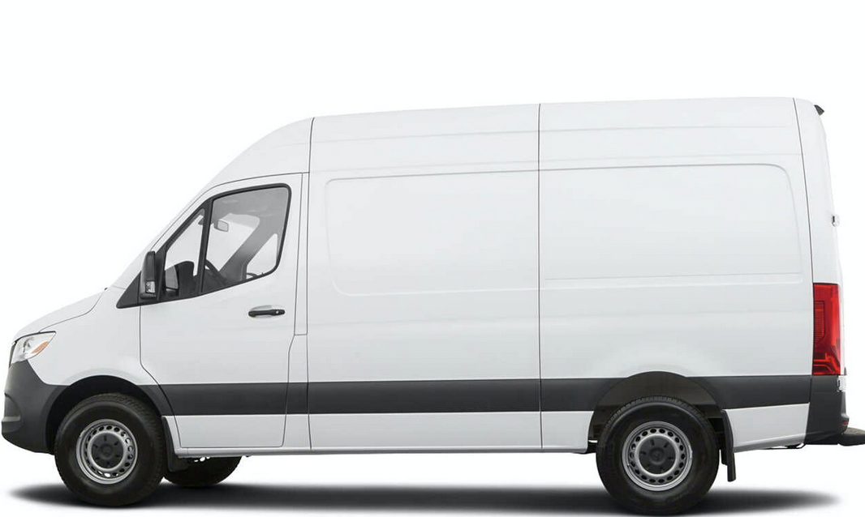
Website Content
Our people power what’s possible.
We are a new company with decades of experience designing and building hardware and software solutions for IOT
Over 30 years experience in designing, marketing, and selling Internet & Mobile based companies.
Focusing on helping public and private entities become successful using RFID and NFC technologies as well as WiFi and Bluetooth BLE 5.0 +
Take the white background from behind the rfidCity.com
Smart Cities
Under the “Over 30 years”
Company is comprised of:
Asset Management Consultants
Electrical Engineer
Logistic Expert
Oil & Gas Specialist
GIS Specialist

Slide 2


Asset Tracking
Hospitality
Manufacturing
Sporting Events
Inventory
Distribution
Asset Tracking
Real-Time Location Services
NFC & RFID for Businesses
Neighborhood Owner Verification
Car Wash VIP Program
Mapping
Tracking Assets in the Field
Wayfinding
Interior Mapping of Hotels & Resorts & Convention Centers
Warehouse Mapping

Slide 3
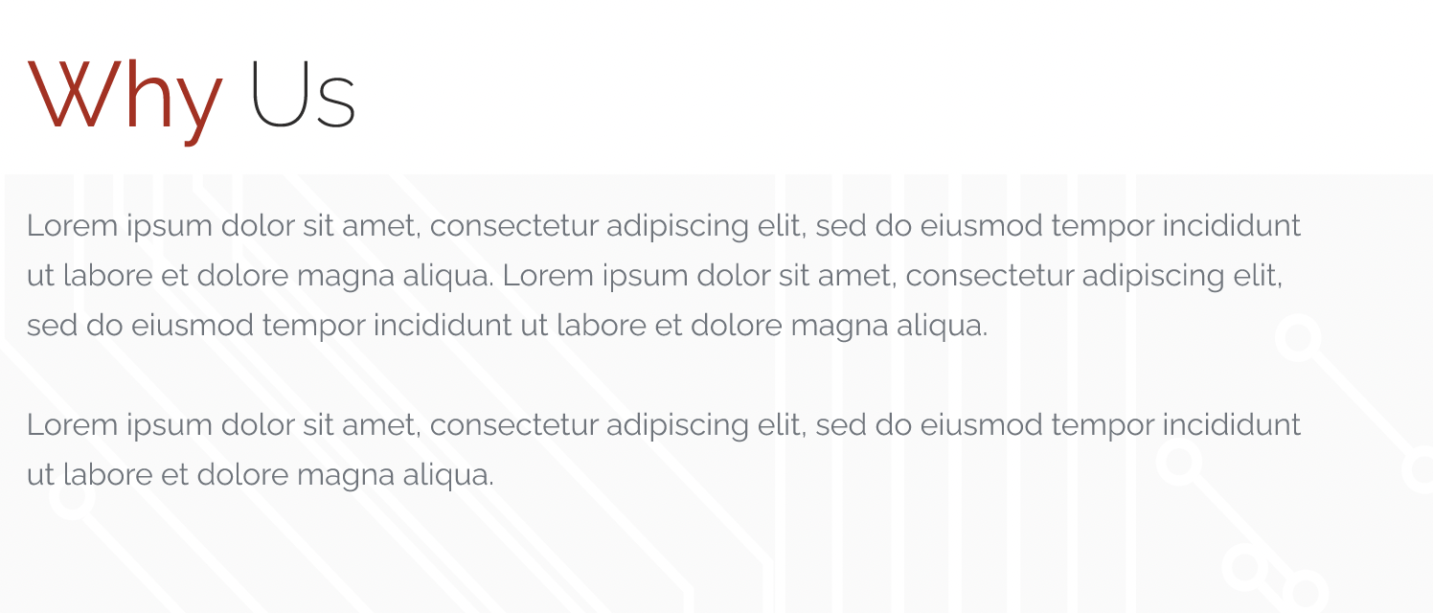
Our teams are focused on delivering the best solutions for your business. We are expanding over the U.S.A. and can leverage our teams in other areas to cover many different facets of technology that bring you the most up to date services.
Our Partners Include:
Qrmaji-QR Code Generator
QBMes- Bulk Messaging for our customers to create tags for all inventory
Bluetooth BLE Beacons are produced with updated 5.0+ and WiFi integration on one chip.
QRTrax.
Wristbands
RFID Cards
RFID Tags
Mobile ID Cards
Apple
Android
Bluetooth Low Energy 5.0
Beacons

Slide 4

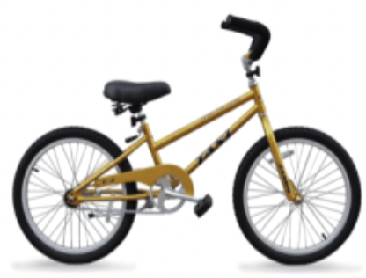
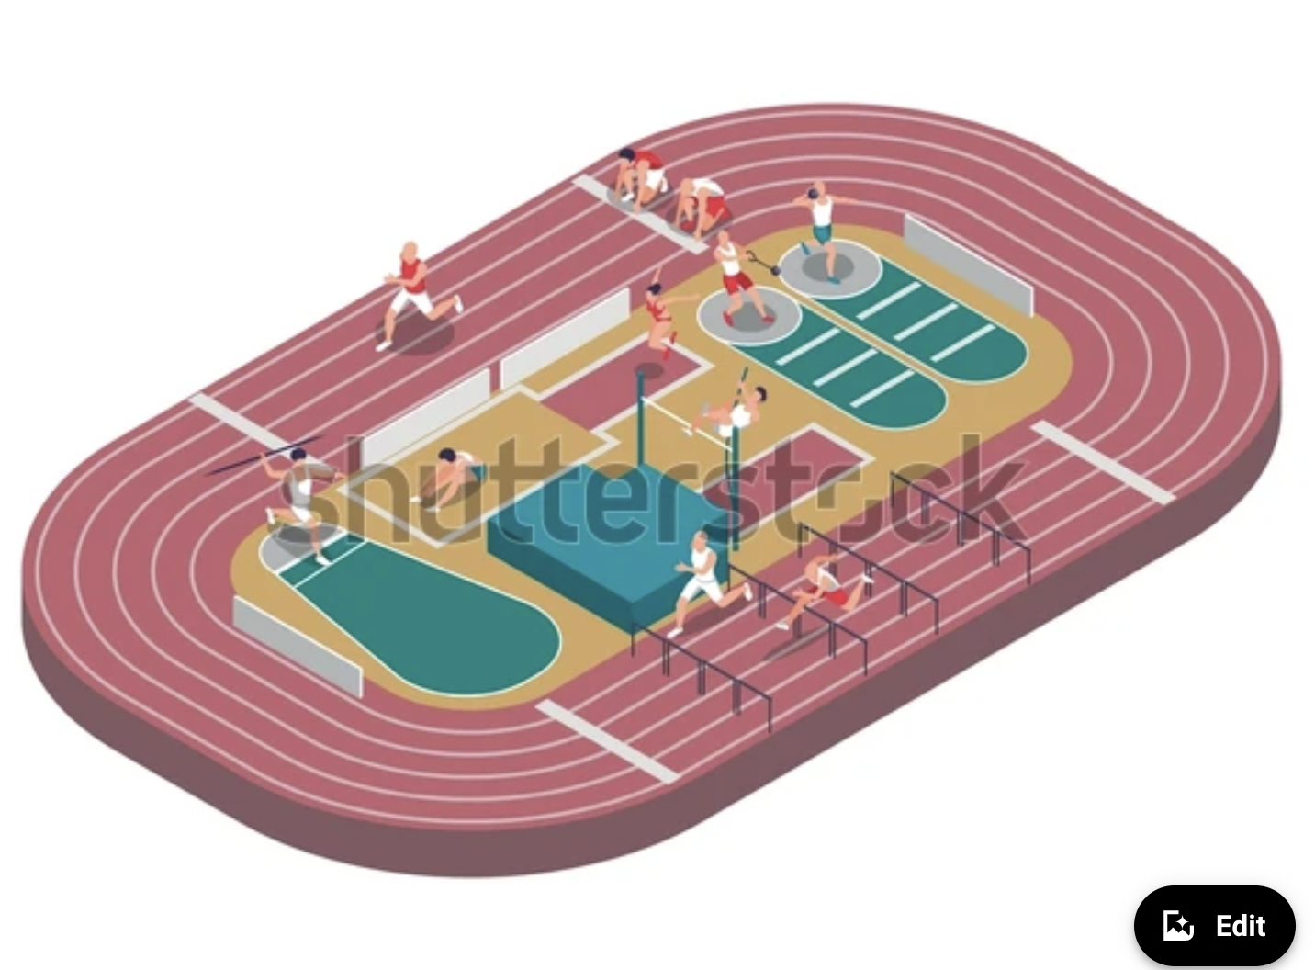

We designed an asset tracking program for a large bicycle rental company. From Delivery-Repairs and back in inventory out for rental
Athletic
Racing
Tracking Athletes
Cameras
Big Screen
Video coverage for family and friends
RFID wristbands for passes, scan DL for people over 21 to enjoy beverages,

Slide 5
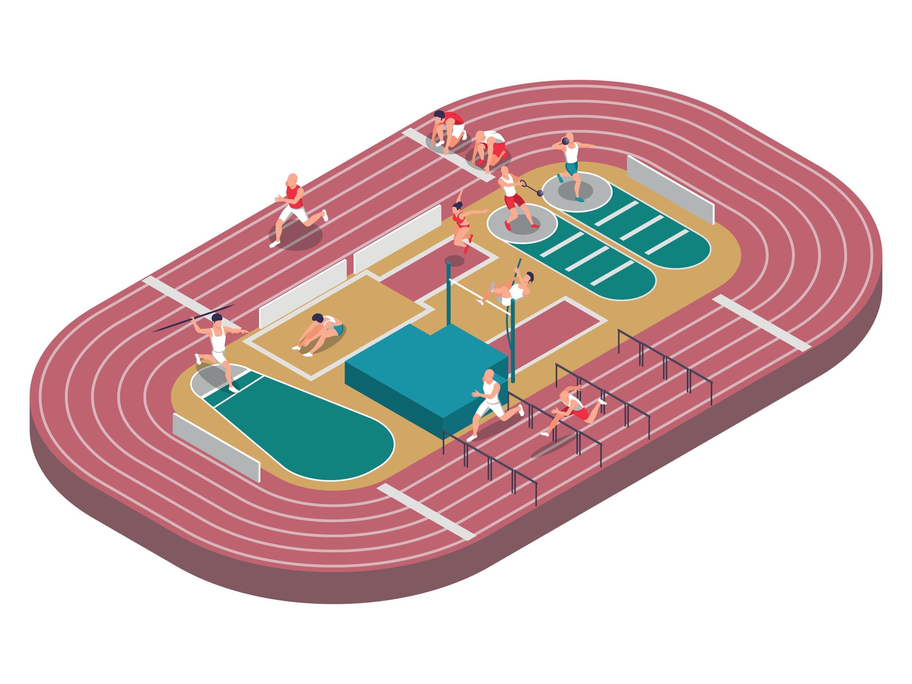
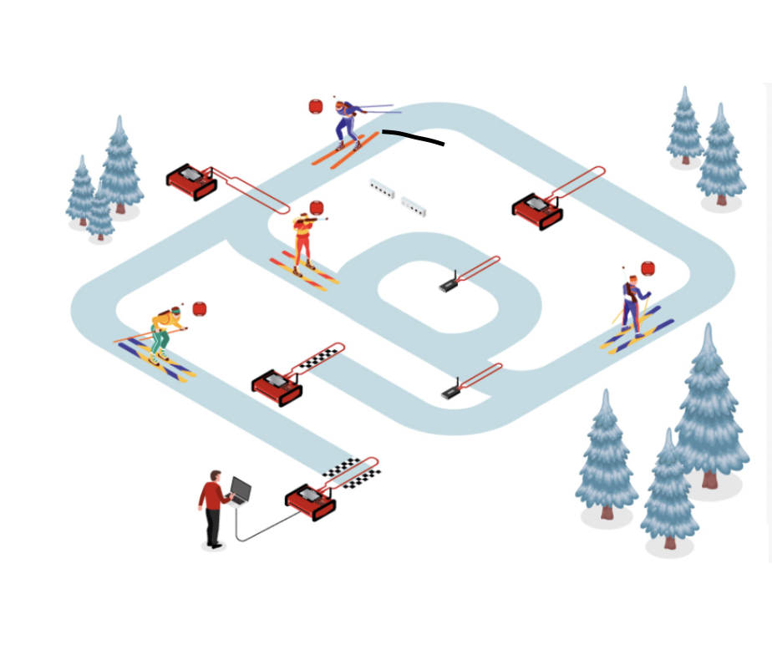
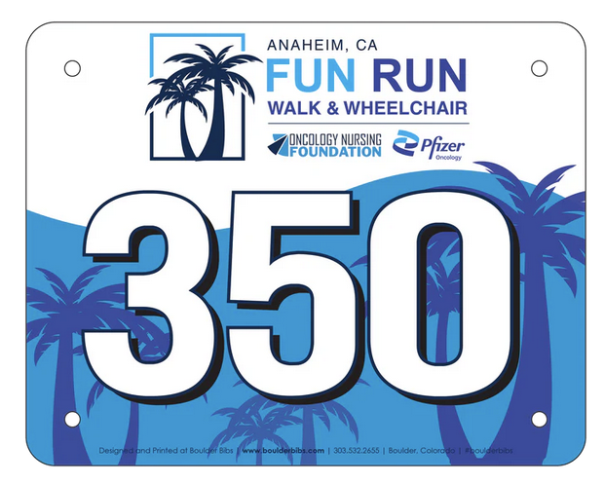
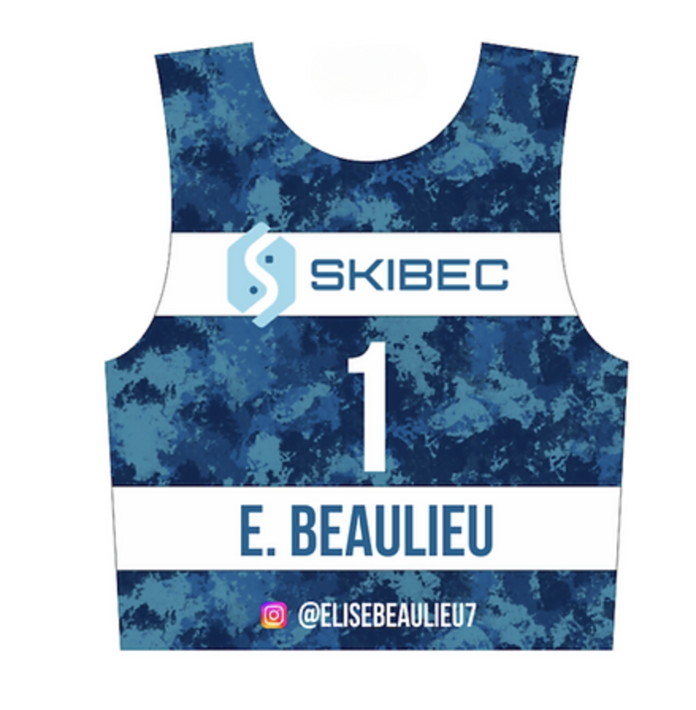
Track Races
Ski Races
Winter Sports
Tyvek is widely regarded as the gold standard for race bibs, offering numerous advantages over traditional paper or laminated materials. Here are a few key reasons why Tyvek is the top choice for race bib printing

Slide 6

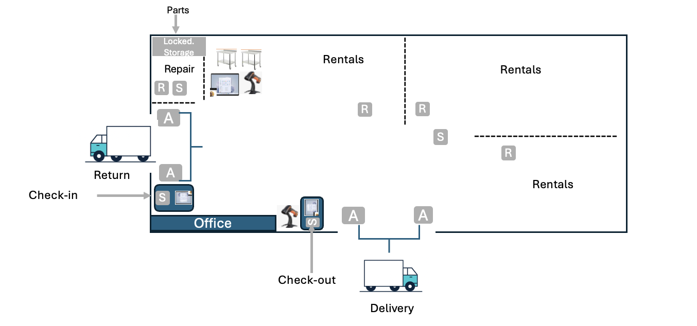
Distribution Centers
Warehouse- Asset Tracking
Asset Tracking-
Navigating through extensive facilities and managing assets spread across various sections, floors, and buildings can be a daunting task for Maintenance Managers and Technicians. The Floor Plan add-on feature from rfidCity transforms this challenge into a streamlined process, offering an interactive digital view of every section of your facility. Discover the myriad of advantages that come with integrating interactive floor plans into your maintenance management operations

Slide 7
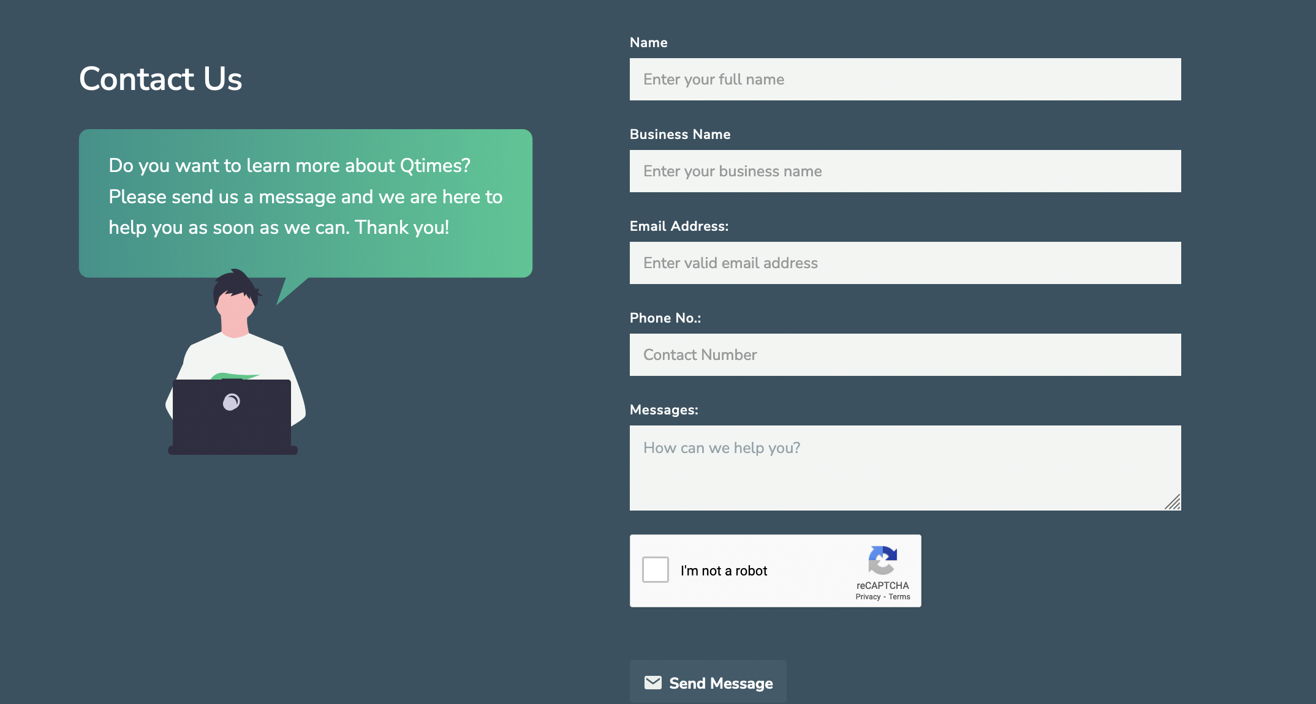
rfidCITY?
Ask us about our Partner Program.

Slide 8
Asset Tracking-
Navigating through extensive facilities and managing assets spread across various sections, floors, and buildings can be a daunting task for Maintenance Managers and Technicians. The Floor Plan add-on feature from rfdCity transforms this challenge into a streamlined process, offering an interactive digital view of every section of your facility. Discover the myriad of advantages that come with integrating interactive floor plans into your maintenance management operations

Slide 9
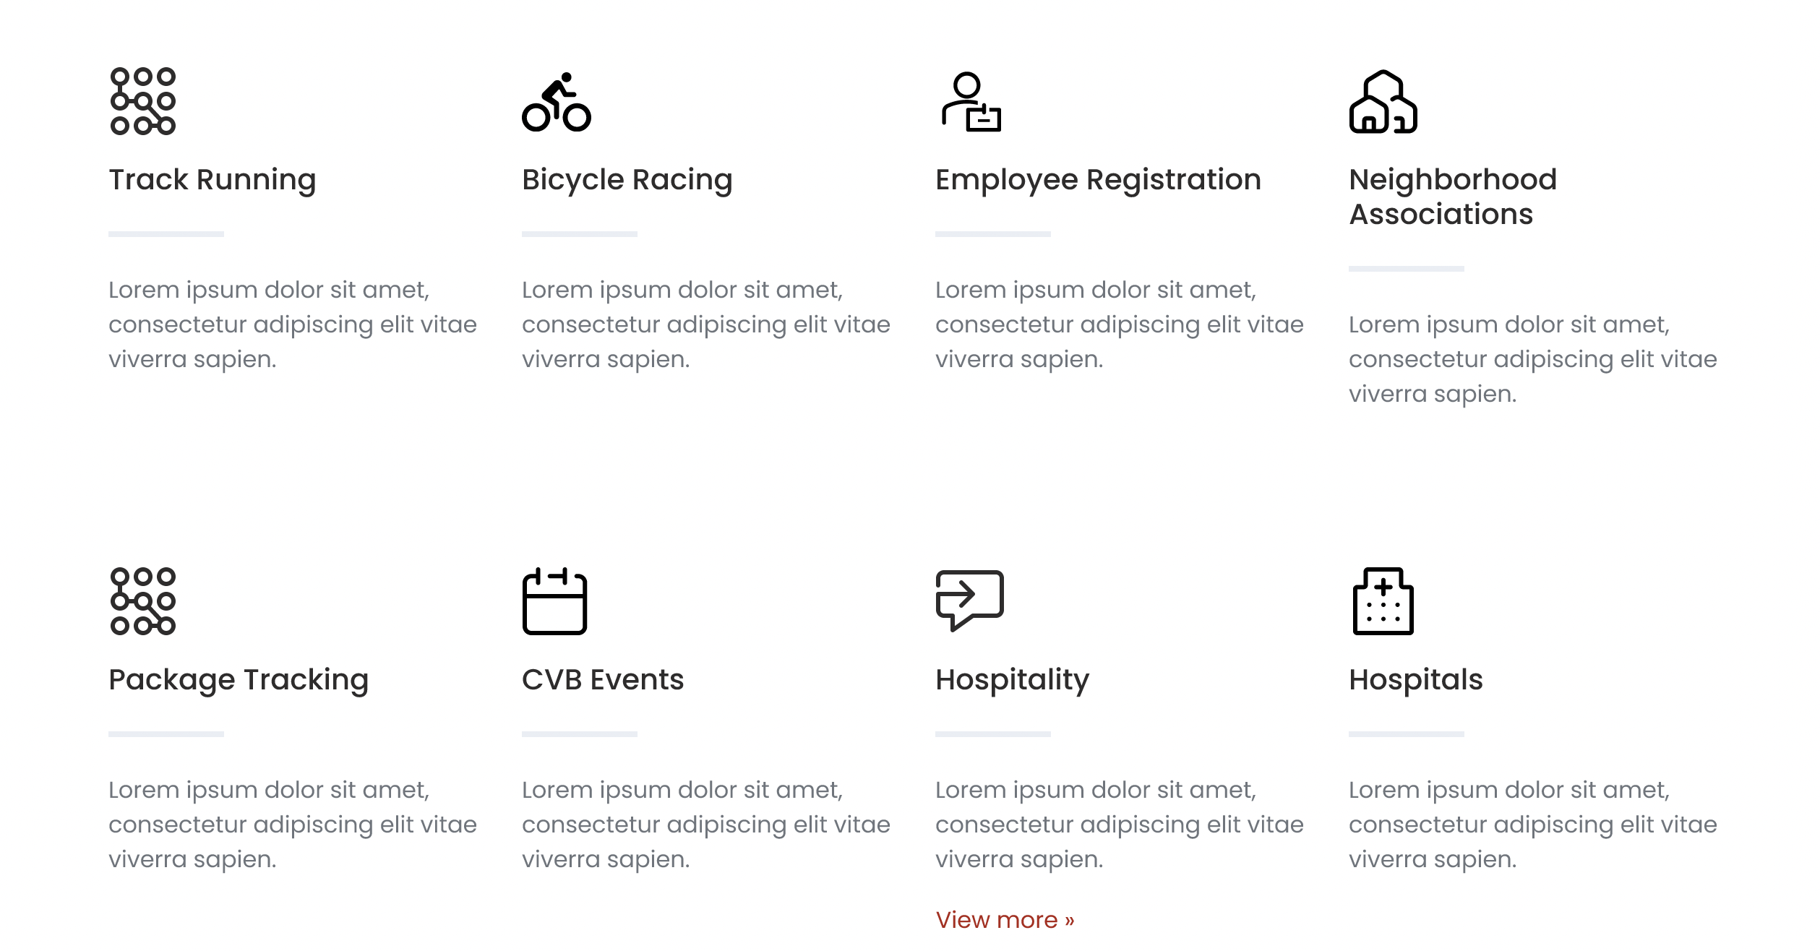
Decisions are made at 100ths of second. Need equipment that can measure each runner
Decisions are made at 100ths of second. Need equipment that can measure each Cycler
Track employees, whether at the warehouse or on the road
Provide security by tracking owners and workers in and out of area
Label packages with RFID assign and register to owner. Reduce theft & wrong package delivery
Concierge at events allows visitors to store bags while attending conferences
Hotels & tourism related companies can track assets to provide better access for guests
Need to know where medicines, critical care equipment and personnel are at all times

Slide 10
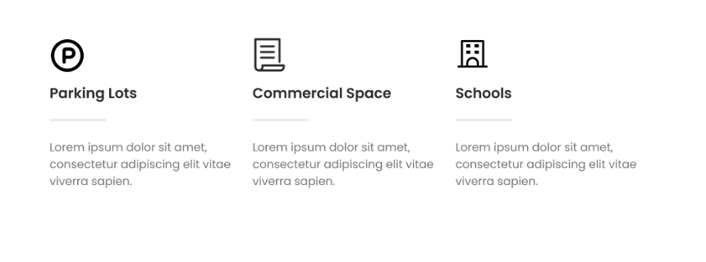
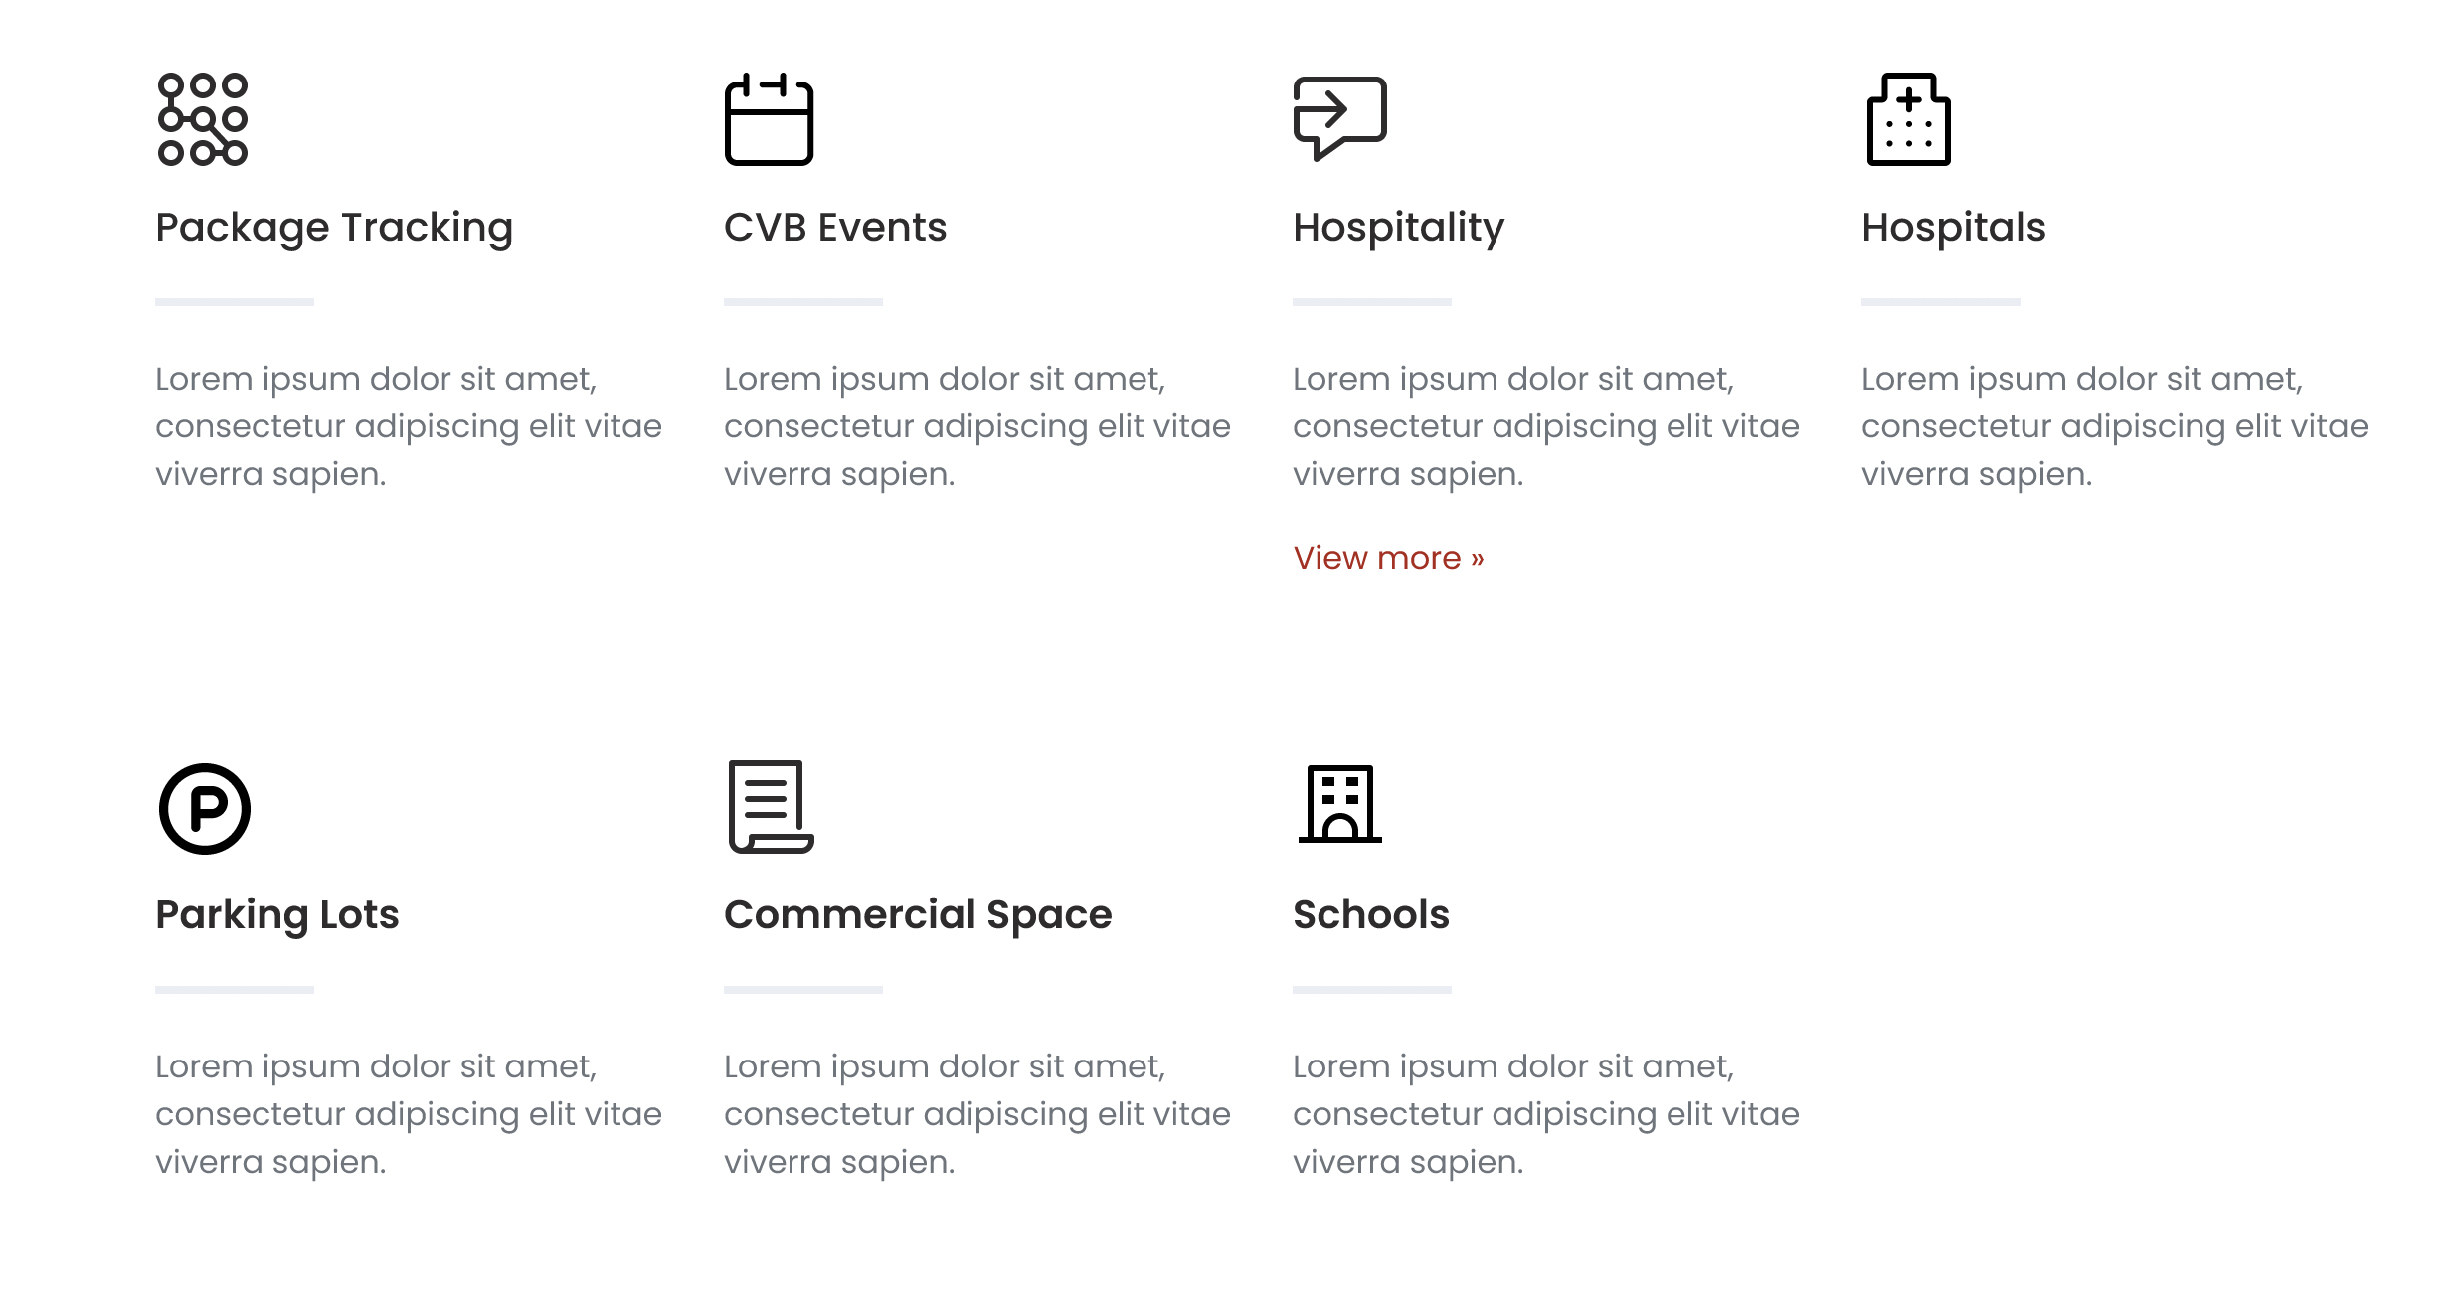
Access & Security
Payment
Tickets
Access & Security
Entry Pass
Tickets
Access & Security to protect children is important. Keep track of cars in the lots and access to the doors
RTLS
Provide solutions for inventory, deliveries and vehicles

